Slide 1

Customer Shopping Behavior Analysis
Uncovering insights from transactional data to guide strategic business decisions.

Slide 2

Project Overview
Data Source
Key Goals
Strategic Impact
3,900 purchases across categories.
Insights into spending, segments, preferences, subscriptions.
Guide business decisions for growth.

Slide 3
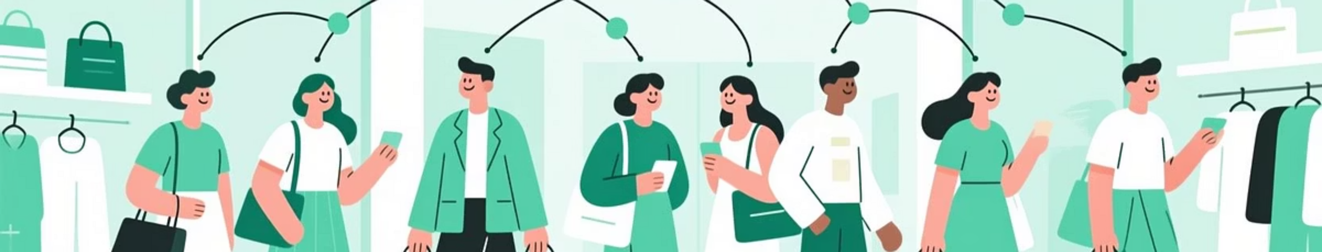



Problem Statement
Retail company seeks to understand customer behavior for improved sales, satisfaction, and loyalty.
Changing Patterns
Data-Driven Need
Identify Trends
Demographics, categories, channels.
Factors like discounts, reviews, seasons.
Key trends and behavioral patterns.

Slide 4

Central Research Question
How can the company leverage consumer shopping data to identify purchasing trends, enhance customer engagement, and optimize marketing and product strategies to drive long-term business growth?

Slide 5

Dataset Summary & EDA
Dataset Details
Data Preparation (Python)
Rows: 3,900, Columns: 18
Data Loading & Initial Exploration
Key Features: Demographics, Purchase Details, Shopping Behavior
Missing Data Handling (median imputation)
Missing Data: 37 values in Review Rating
Column Standardization (snake_case)
Feature Engineering (age_group, purchase_frequency_days)
Data Consistency Check (dropped promo_code_used)
Database Integration (MySQL)

Slide 6

SQL Analysis: Key Business Transactions
1
Revenue by Gender
Male: $157,890, Female: $75,191
2
Discounted High Spenders
Customers using discounts, spending above average.
3
Top 5 Reviewed Products
Gloves (3.86), Sandals (3.84), Boots (3.82), Hat (3.8), Skirt (3.78)
4
Shipping Type Spend
Express: $60.48, Standard: $58.46

Slide 7


SQL Analysis: Subscription & Product Insights
Subscriber Spend
Top 5 Discounted Products
Customer Segments
Subscribers: Avg $59.49, Total $62,645
Hat (50%), Sneakers (49.66%), Coat (49.07%), Sweater (48.17%), Pants (47.37%)
Loyal (3116), Returning (701), New (83)
Non-subscribers: Avg $59.87, Total $170,436

Slide 8
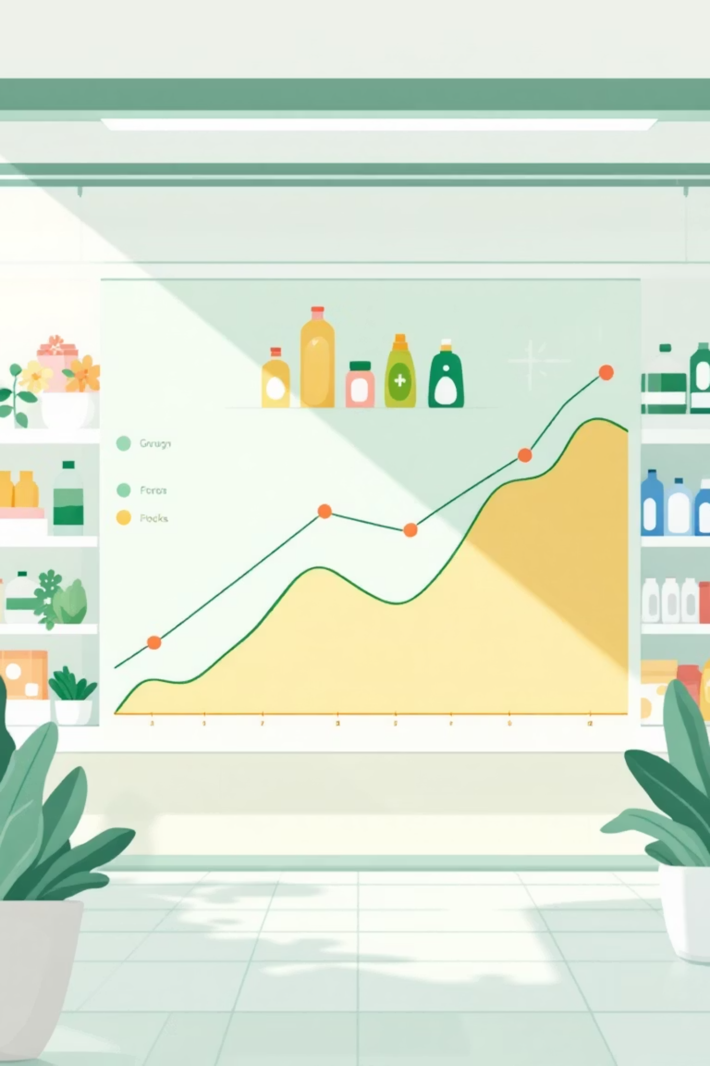
SQL Analysis: Product & Age Group Trends
Top 3 Products by Category
Accessories: Jewelry, Sunglasses, Belt
Clothing
Blouse, Pants, Shirt
Footwear
Sandals, Shoes, Sneakers
Outerwear
Jacket, Coat
Repeat Buyers & Subscriptions
Repeat buyers (5+ purchases): No (2518), Yes (958)
Revenue by Age Group
Young Adult: $62,143
Middle-aged: $59,197
Adult: $55,978
Senior: $55,763

Slide 9
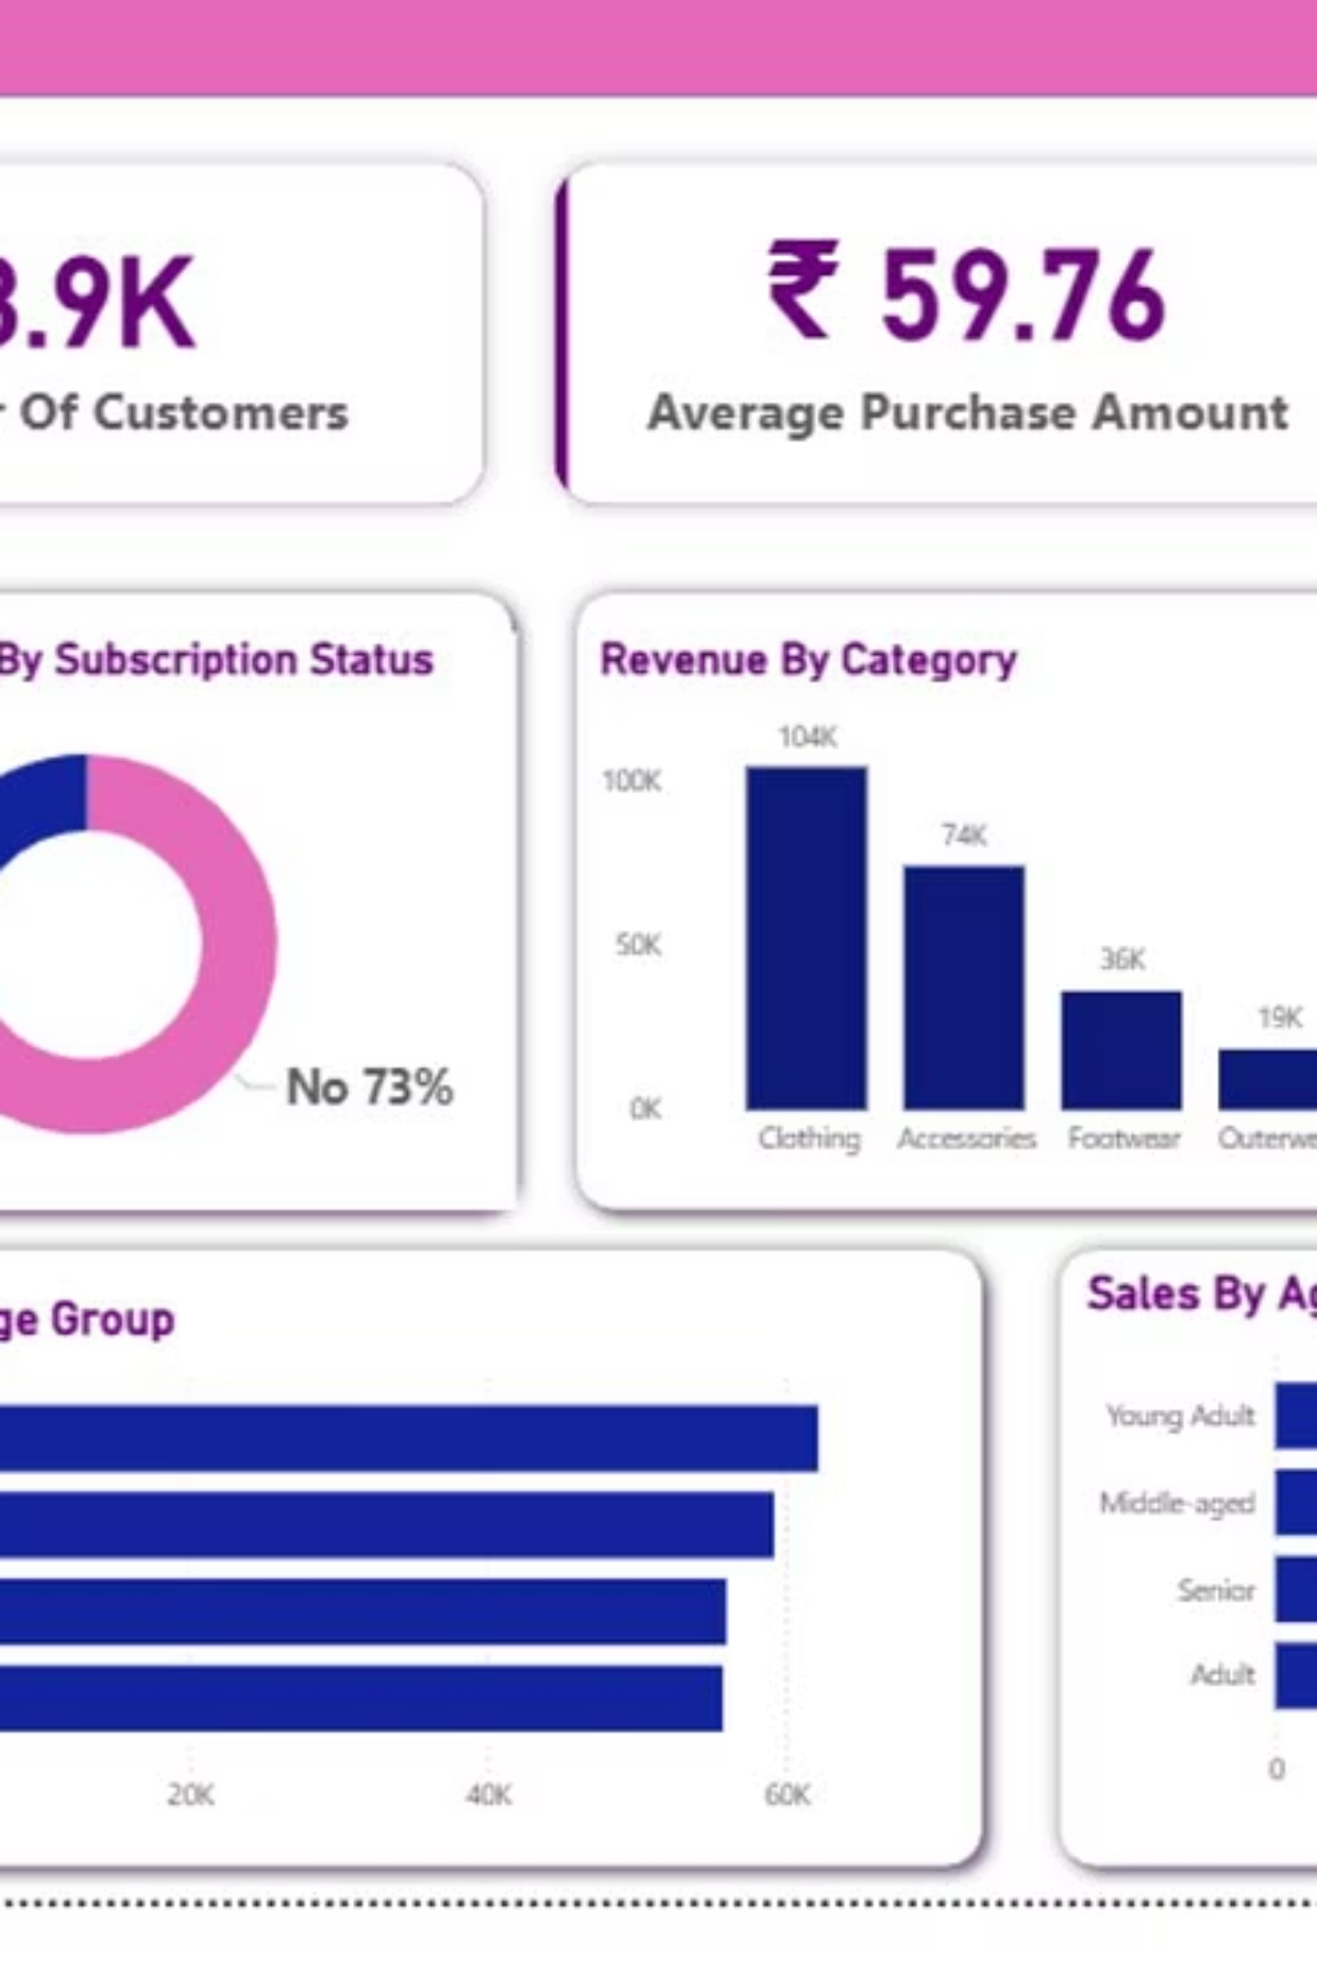
Dashboard in Power BI
Visualizing key insights for actionable business intelligence.

Slide 10
Business Recommendations
Boost Subscriptions
Promote exclusive benefits.
Customer Loyalty Programs
Reward repeat buyers.
Review Discount Policy
Balance sales with margin.
Product Positioning
Highlight top-rated items.
Targeted Marketing
Focus on high-revenue groups.

